Slide 1

Data Warehouse Project
Team: Binary Bots
Vishnu Charugundla
Rishikesh Ramesh
Pranav Mahesh Mekal

Slide 2
What database did we select?
As a part of our Data Warehouse project, we have selected to work with the “Chinook” database
The Chinook data model represents a digital media store
It has tables for artists, albums, media tracks, invoices and customers.
Media related data was created using real data from an iTunes Library.

Slide 3
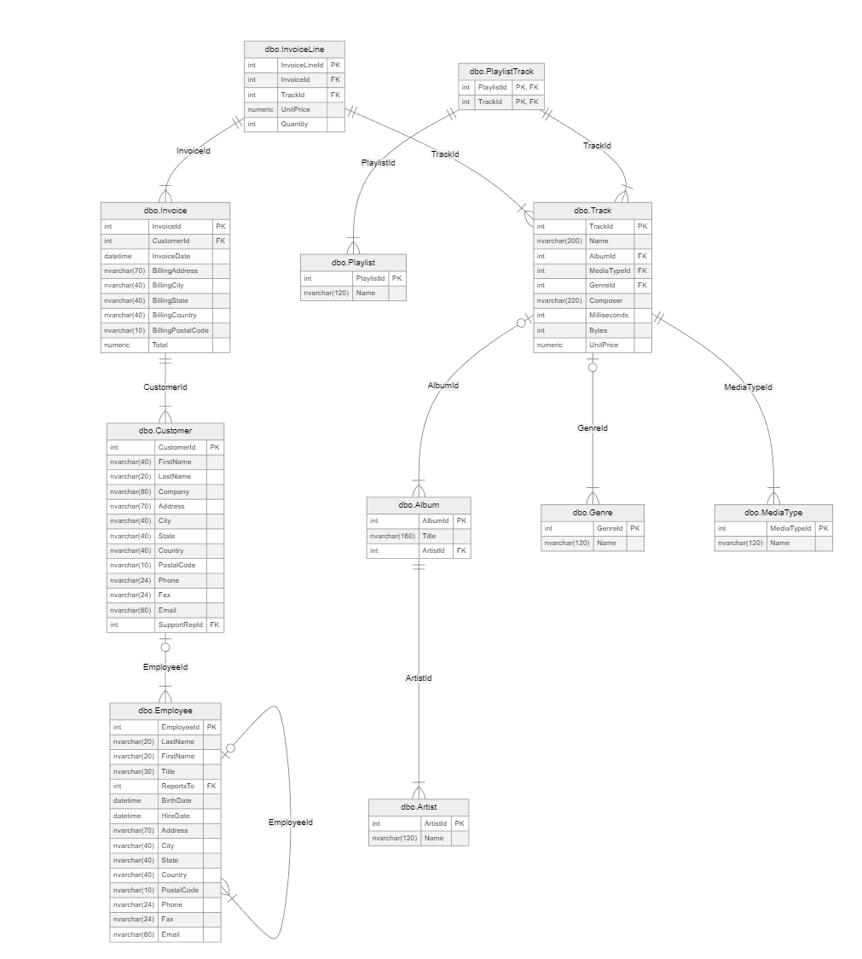
Schema Visualization

Slide 4
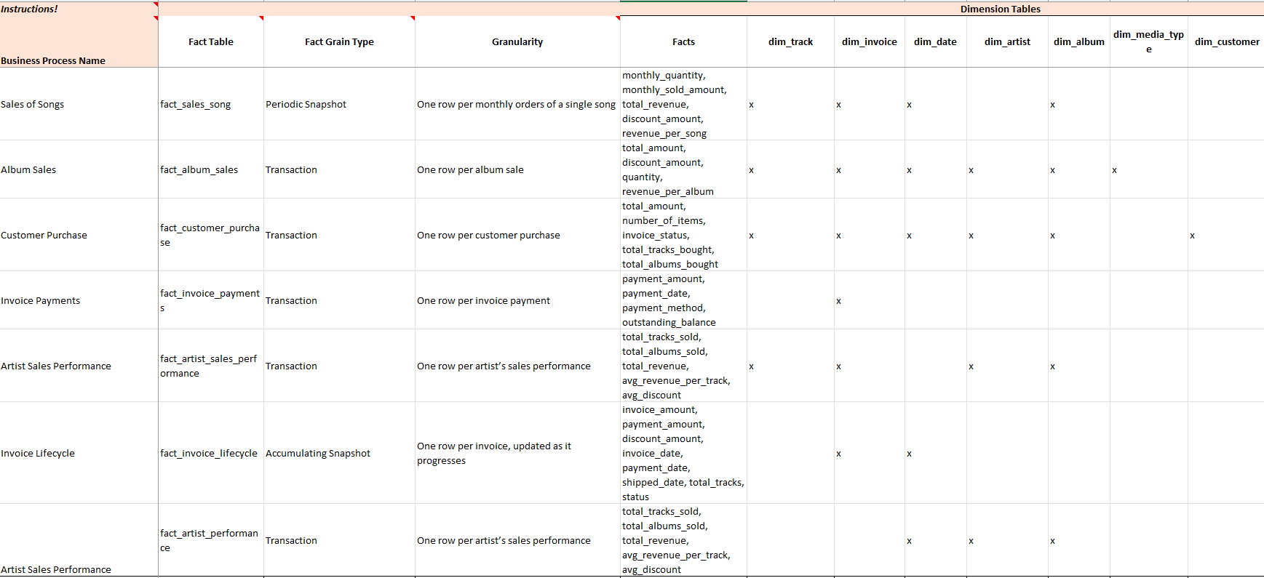
Bus Matrix

Slide 5
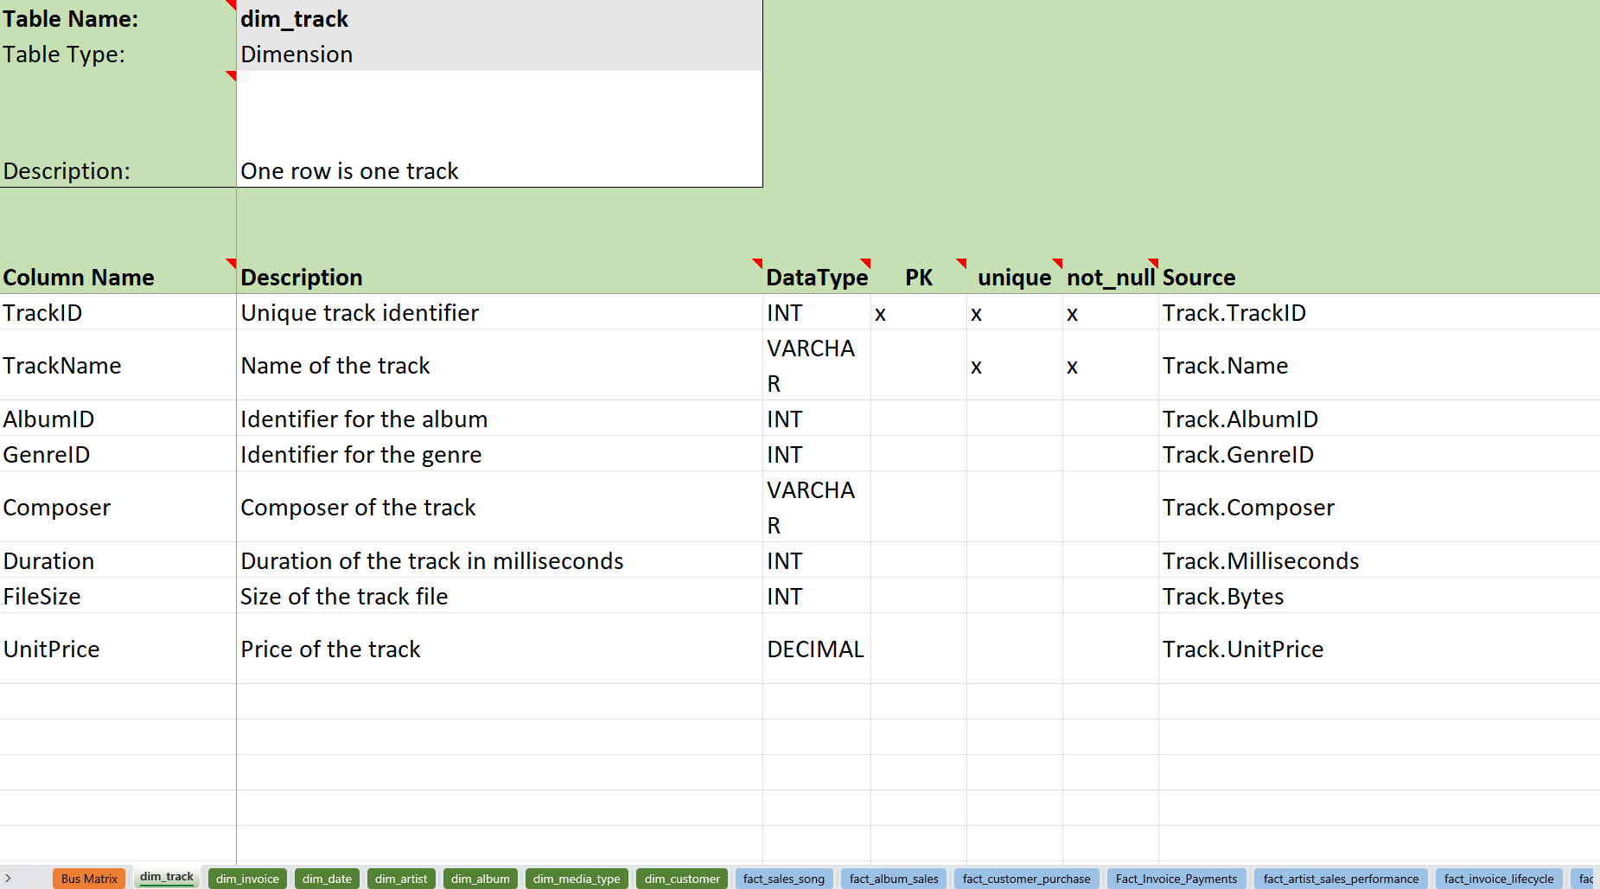
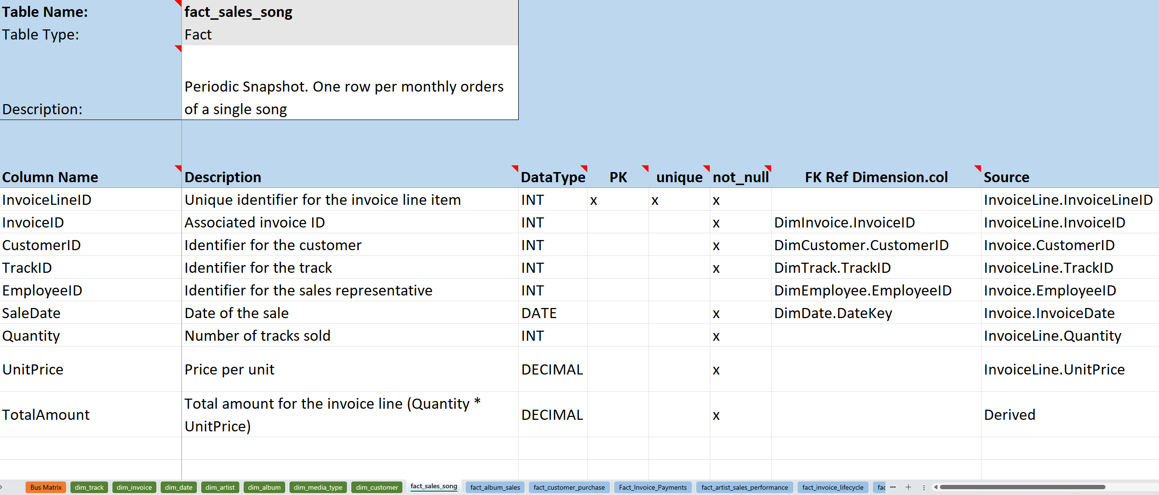
Detailed Dimensional Model

Slide 6
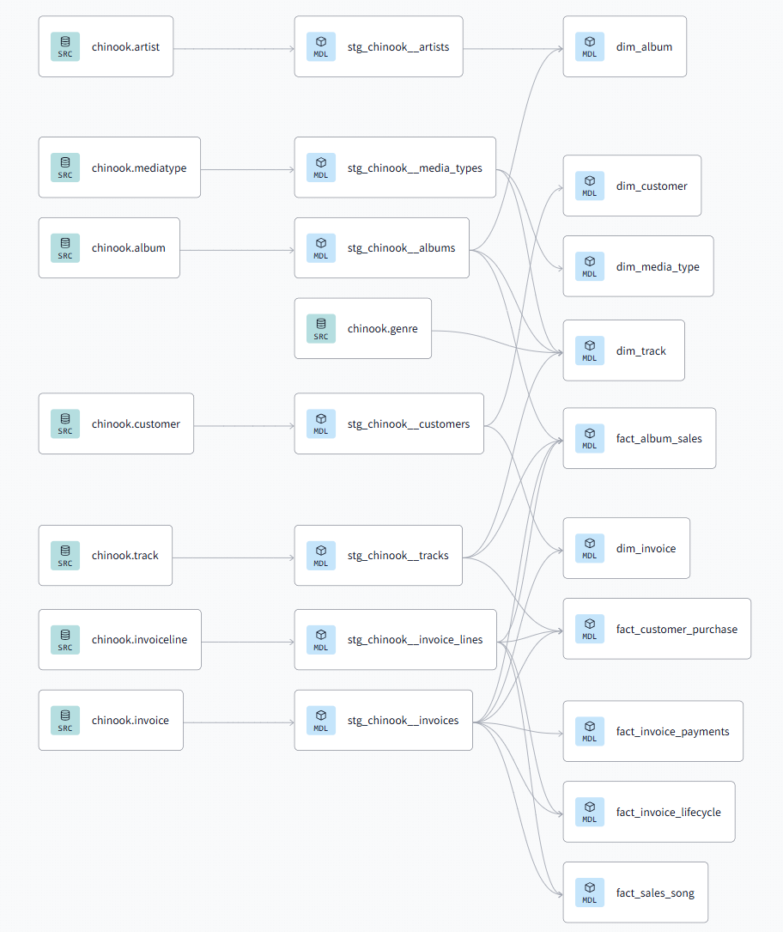
Data Lineage Source to Target mapping

